Slide 1
InterLAN Internet Exchange
update

Slide 2
InterLAN Internet Exchange
Over 100 ASNs from Romania as well as from the region and worldwide connected
14 locations: 7 in Bucharest, 7 in major cities representing regions of Romania and 1 in the heart of Europe, Frankfurt, Germany
Multicast Exchange Platform TVX
6 DNS Root anycast instances: D, E, F, J, K, L
AS112 service
RIPE NCC RIS Remote Route Collector
IXP Manager peering tool

Slide 3
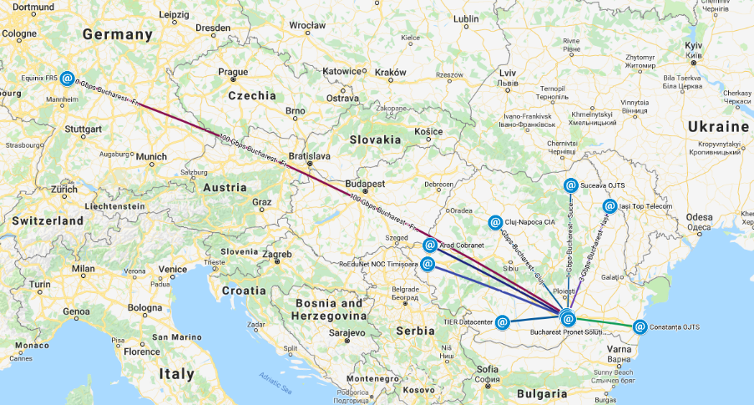
National & regional infrastructure
136 ports in 15 POPs:
7 POPs in Bucharest over 40G ring (NXDATA-1, NXDATA-2, Voxility, M247, Teletrans, Radiocom, Ines Group)
7 POPs over 10G links in Arad, Cluj-Napoca, Constanța, Craiova, Iași, Suceava, Timișoara
1 POP over 100G link in Frankfurt Equinix FR5

Slide 4
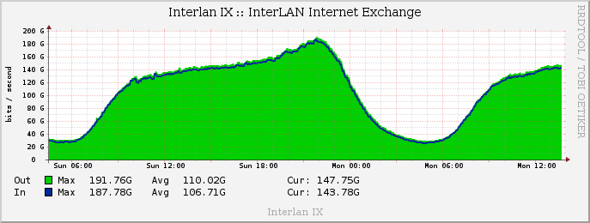
Connected capacity
Ports:
10 ports x 100M
44 ports x 1G
76 ports x 10G
1 port x 40G
5 ports x 100G
Total connected capacity: 1,345T
97% of customers are using route-servers
98% of customers are IPv6 enabled

Slide 5
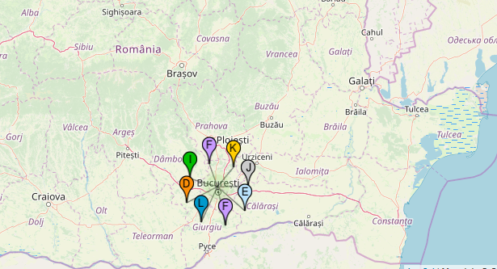
DNS Root Servers
As of 2019-09-18, the root server system consists of 1017 instances operated by the 12 independent root server operators.
All 8 DNS Root Anycast Servers in Romania are hosted in Bucharest.
6 out of 8 DNS Root Anycast Servers in Bucharest are hosted by InterLAN:
D-Root (University of Maryland)
E-Root (NASA Ames Research Center)
F-Root (Internet Systems Consortium)
J-Root (Verisign)
K-Root (RIPE NCC)
L-Root (ICANN)

Slide 6
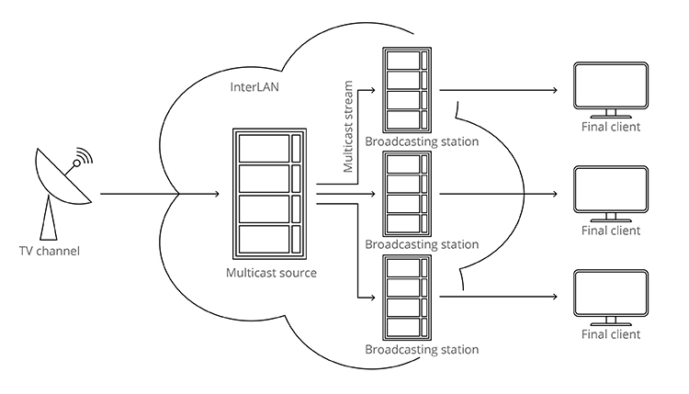
TV Exchange Media Platform
57 streams
40 channels
Multicast MPTS/SPTS and unicast
Stream management app (currently in development)

Slide 7
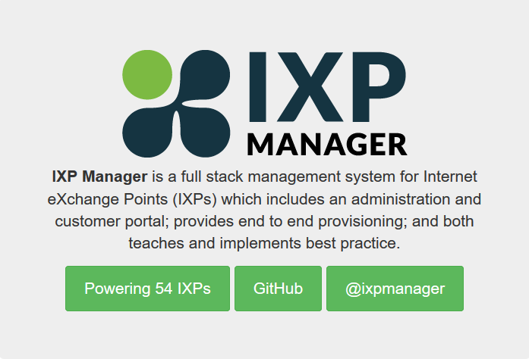
IXP Manager
Management system for Internet Exchanges
Home: Information about your connection
Member information: Who else is connected?
Peering: Manage your peering connections
Documentation: Docs and configuration examples
Statistics: Your traffic graphs, member graphs, POP graphs
Support: Contact information
My Account: Your personal details

Slide 8
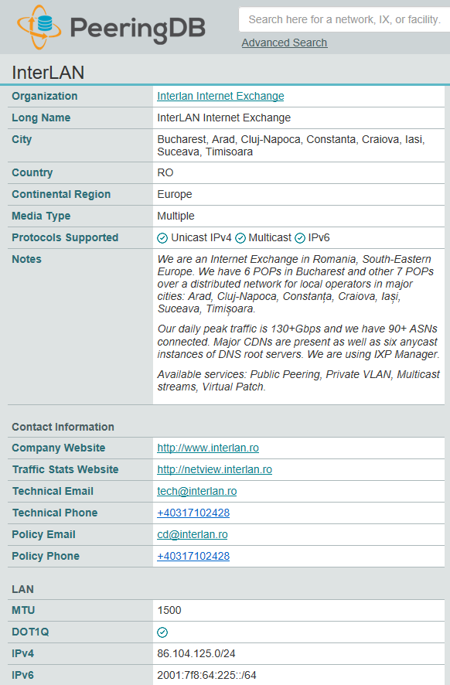
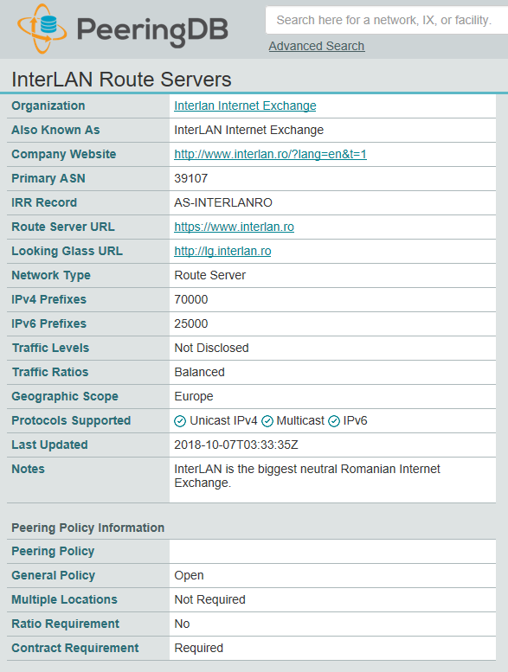
PeeringDB Information
https://www.peeringdb.com/ix/270
https://www.peeringdb.com/net/11965

Slide 9
Events Hosted by InterLAN
25th Euro-IX Forum: 26 - 28 October 2014, Bucharest
RONOG 1: 29 October 2014, Bucharest
RONOG 2: 29 October 2015, Bucharest
RIPE 71: 16 – 20 November 2015 Bucharest
RONOG 3 & ION Meeting: 12 October 2016, Bucharest
RONOG 4: 31 October 2017, Bucharest
RIPE SEE 7: 18-19 June 2018, Timișoara
RONOG 5: 23 October 2018, Bucharest
RONOG 6: 1 October 2019, Bucharest

Slide 10
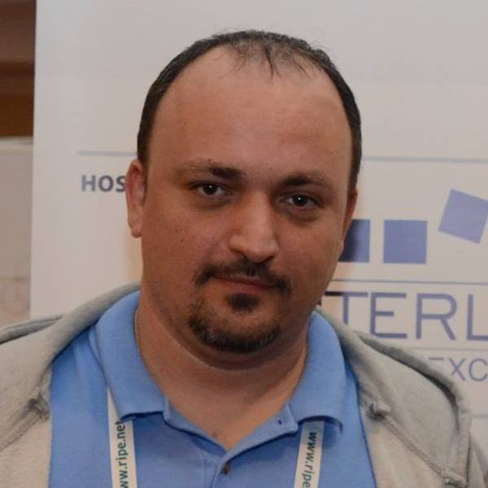
Questions?
eric.baleanu@interlan.ro
facebook.com/ericandrei
twitter.com/ericandrei
linkedin.com/in/ericandrei/
Eric Andrei Băleanu InterLAN

